Slide 1
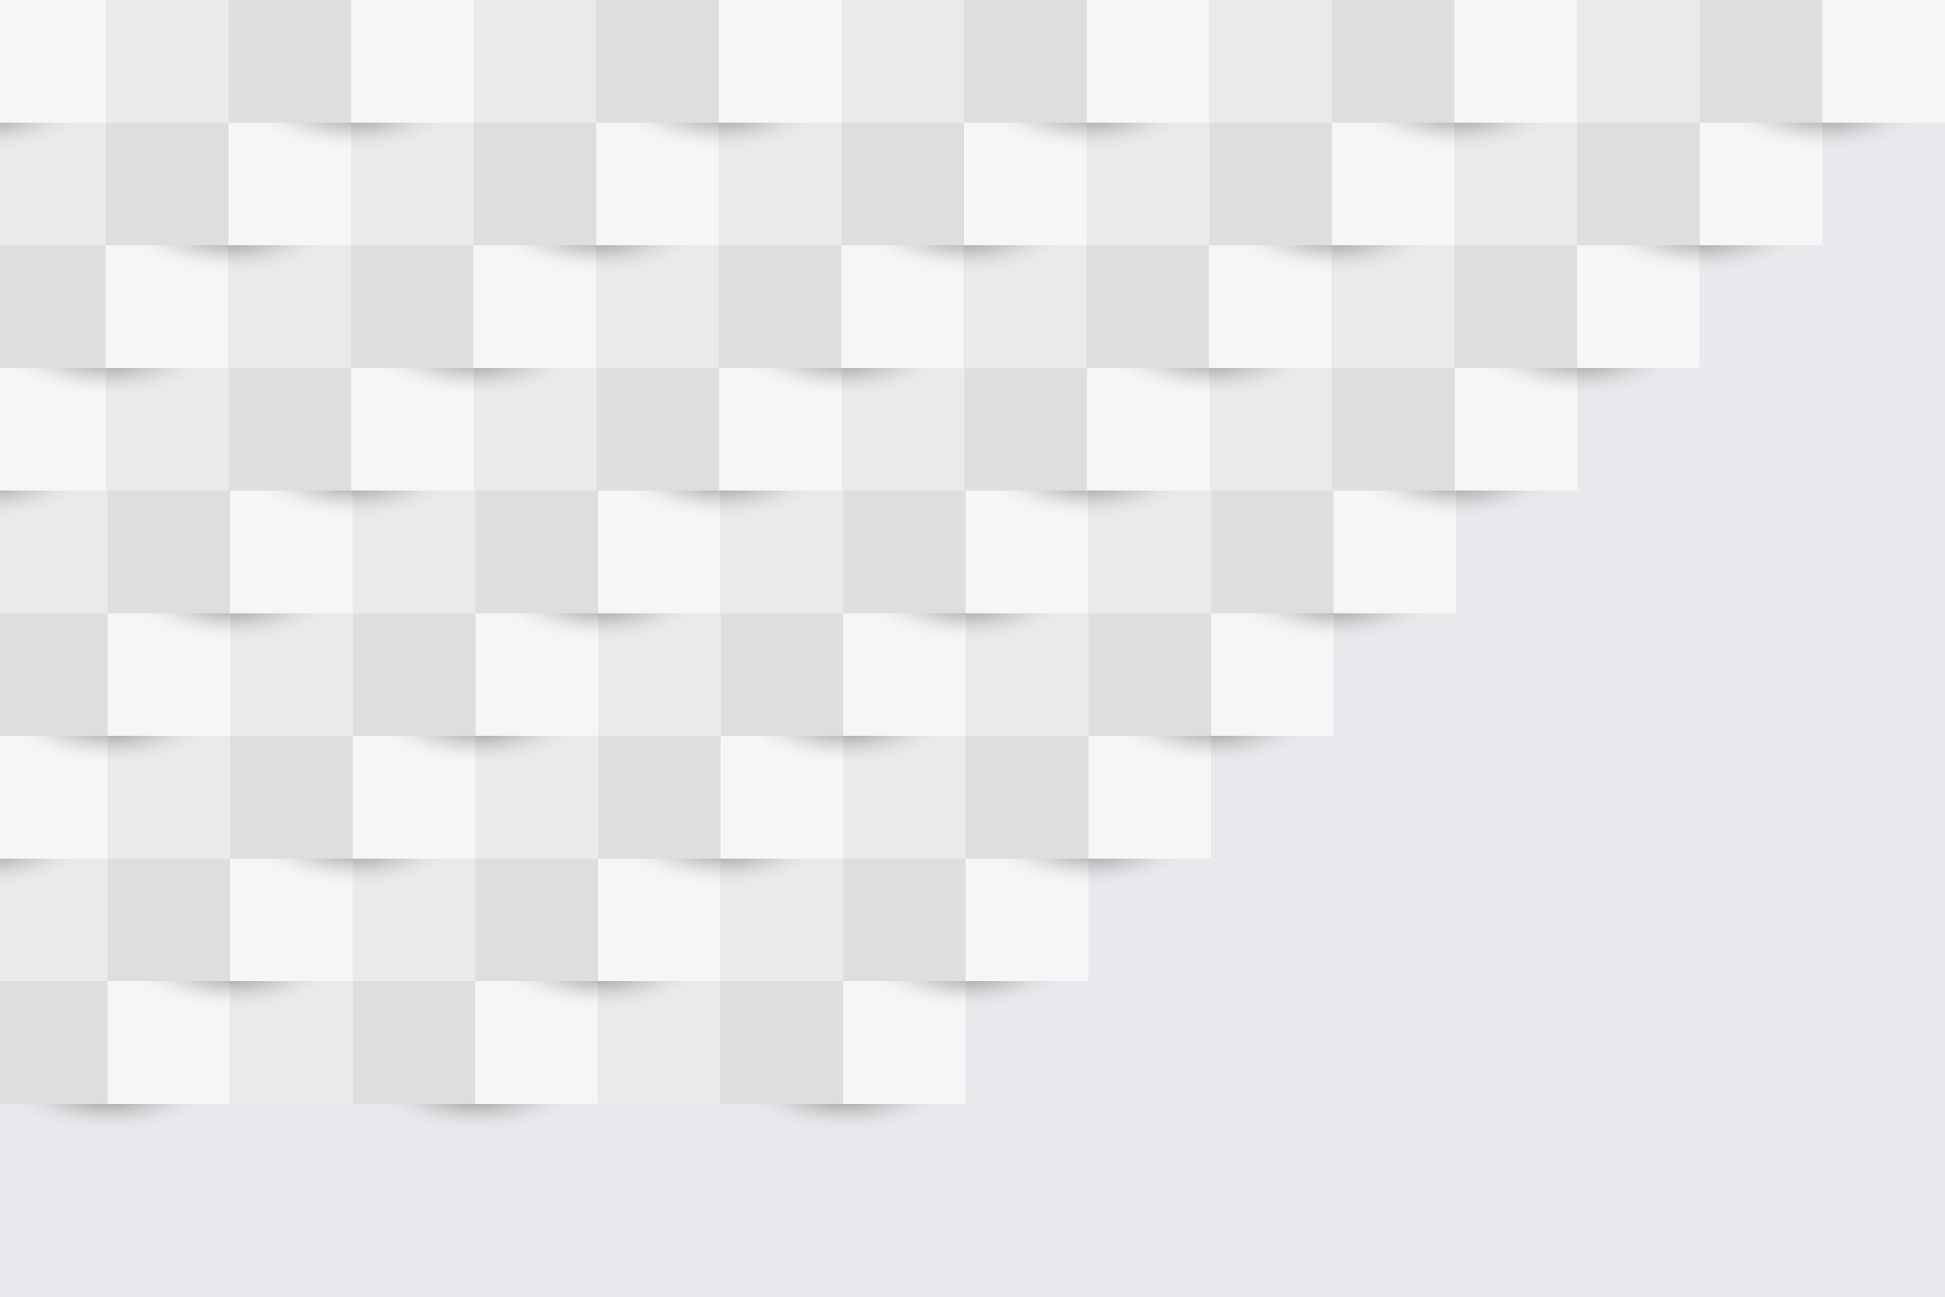

ProjecTile
Tasks made easy
Team 1 - Nicholas Comeau | Sophie Hsu | Benjamin Pye | Soliloquy Yarrow

Slide 2

What is PROJECTILE
Projectile is a collaborative project management tool designed to streamline teamwork and enhance productivity.
It offers features such as task management, real-time collaboration, chat, and customizable workflows, all within a user-friendly interface.

Slide 3
What are PROJECTILE’s Features
Users can register/login
Users can create mosaics
Users can create columns & tiles
User can add member to collaborate
Users can assign tiles to members
Users can create to do lists
Users can update the details
User manage their account

Slide 4
PROEJCTILE’s Features Continued
Users can drag and drop tiles
Users can chat
Users get live update

Slide 5
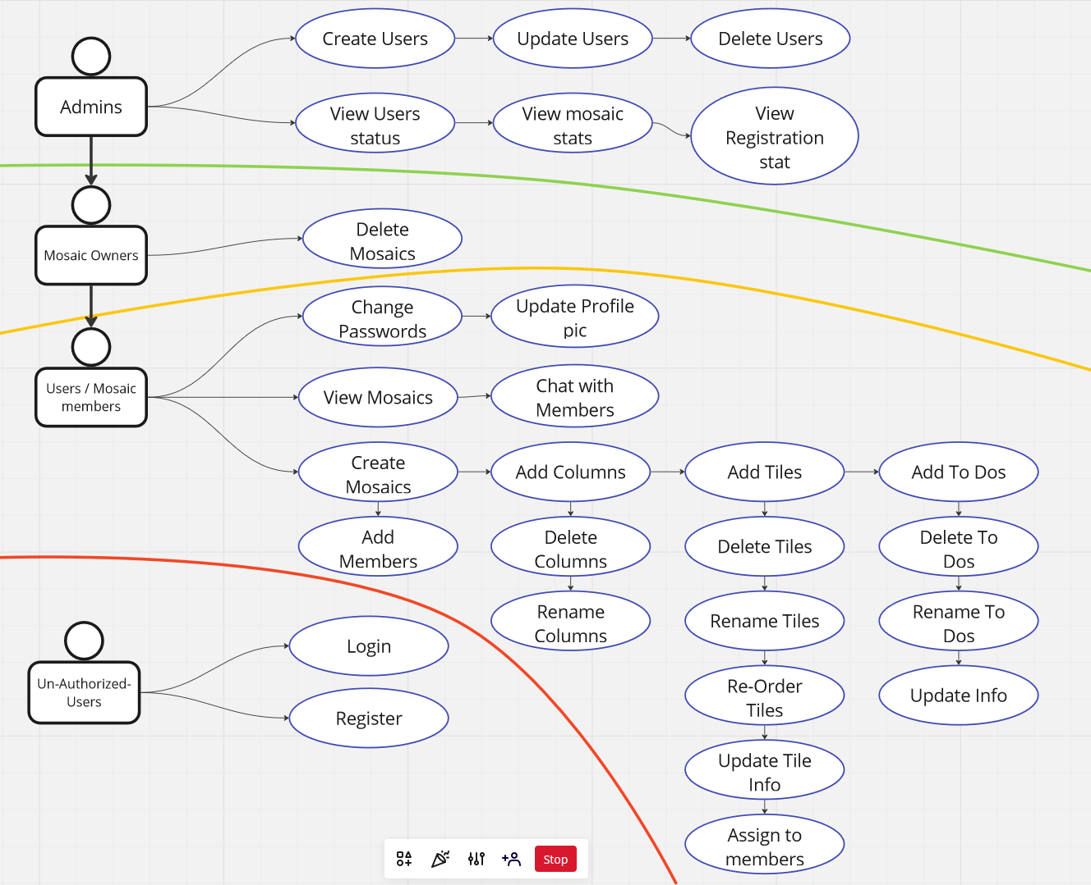
PROJECTILE’s
Use Case Diagram

Slide 6
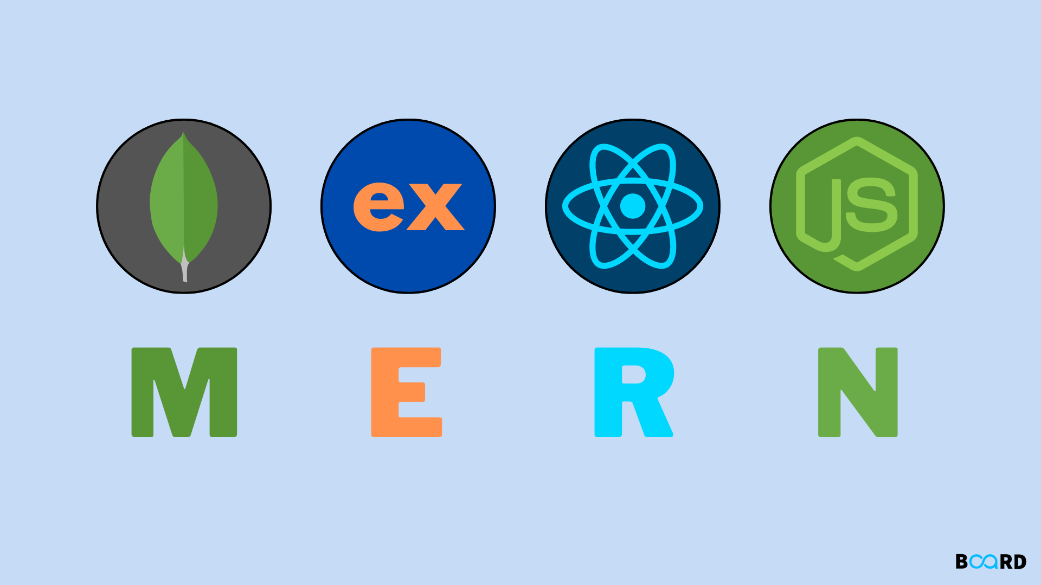
Projectile uses MERN TECH STACK
MongoDB
Express.js
React.js
Node.js
Why?
Single-language development
High performance
Scalability
Real-time capabilities
Cross-platform compatibility

Slide 7
Technologies used for Projectile
React Beautiful DnD
Socket.io
Tailwind CSS
React Datepicker

Slide 8
Technologies used for Projectile CONTINUED
Material UI
React Toastify
Chart.js
Daisy UI

Slide 9
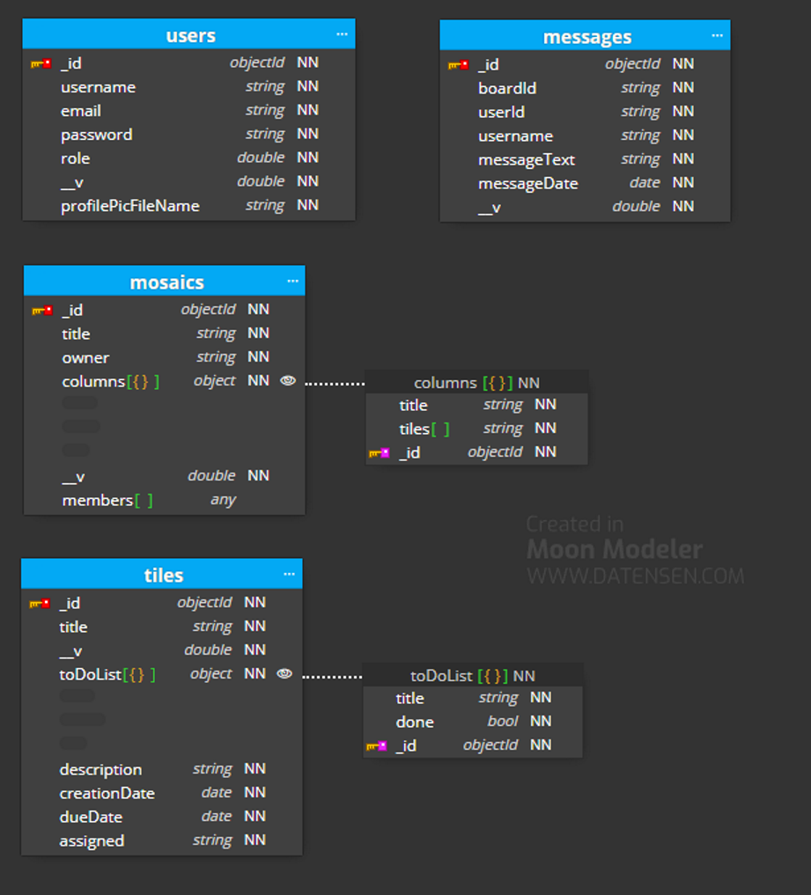
PROJECTILE’s
Database Design
NoSQL
Flexible Data Model
Schema Evolution
Seamless Integration

Slide 10
What were the Challenges
CI/CD Pipeline
WebSocket
MongoDB
DaisyUI

Slide 11
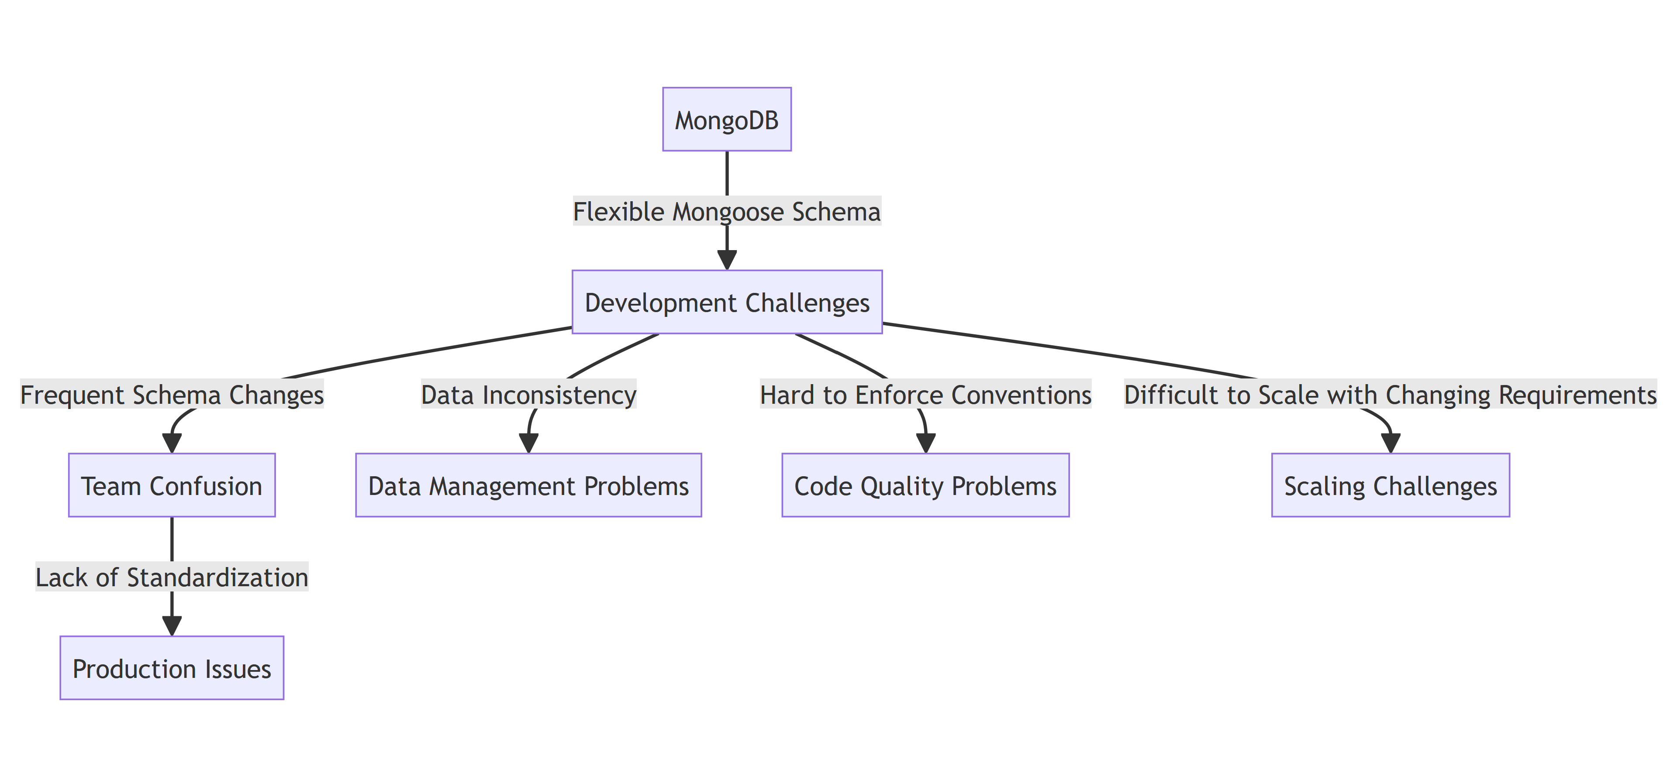
Mongodb

Slide 12
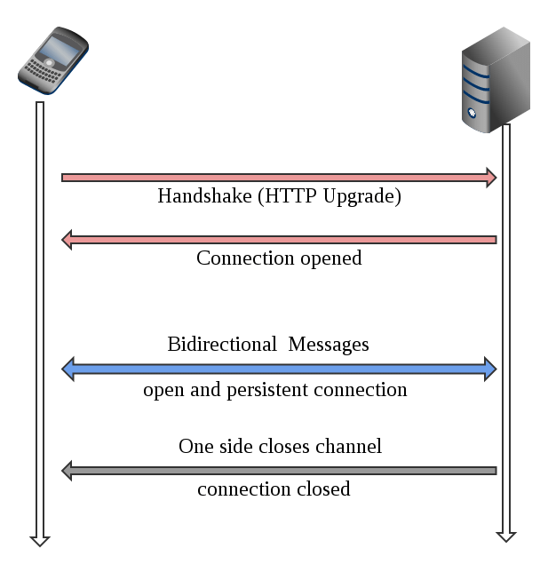
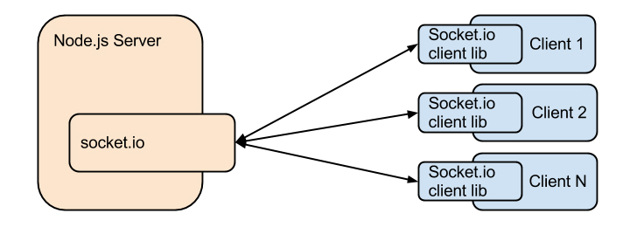
Websocket what is it?

Slide 13
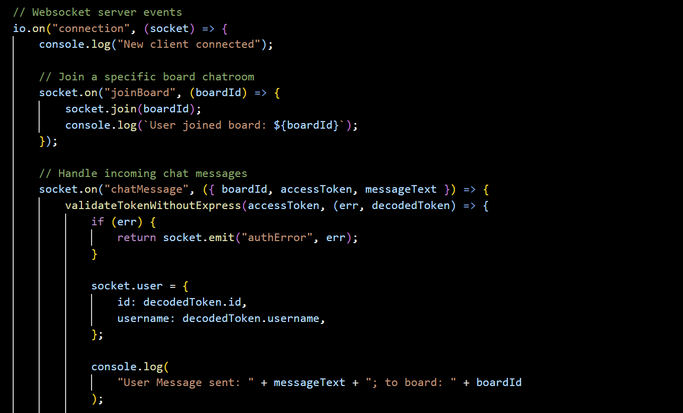
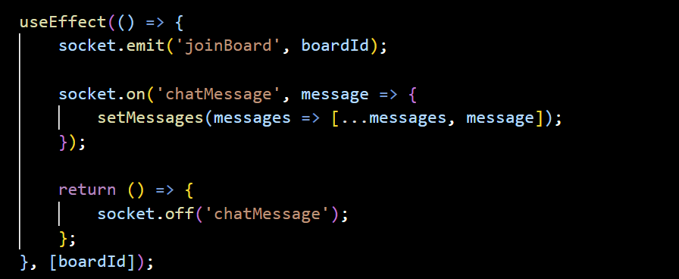
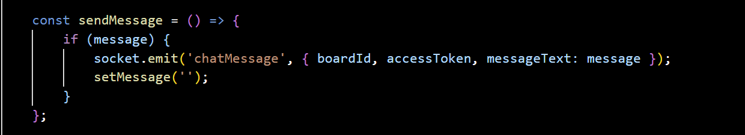
Websocket Our Implementation
Server
Client

Slide 14
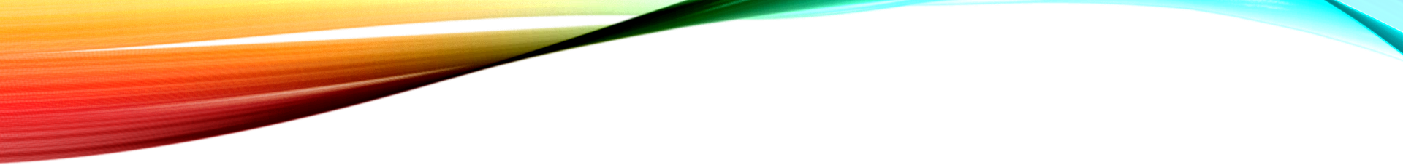
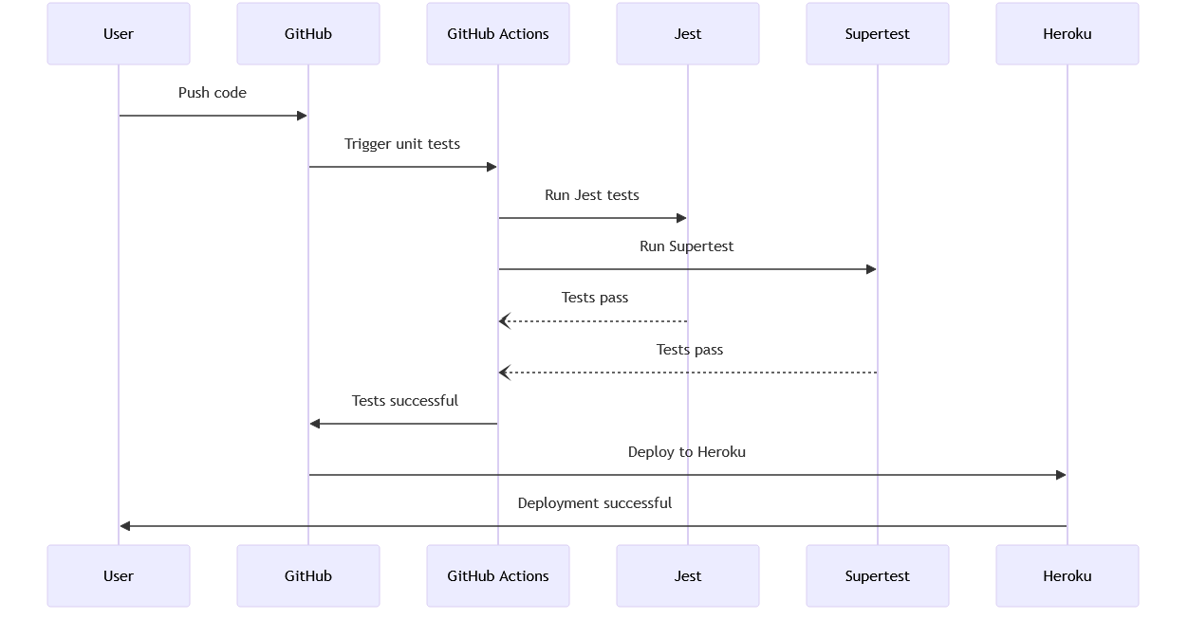
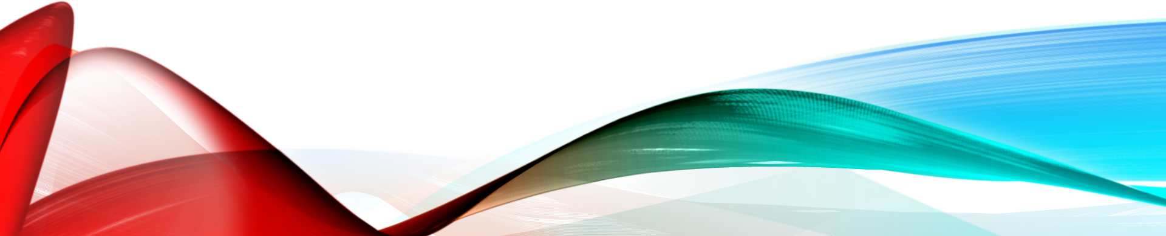
CI/CD Pipeline

Slide 15
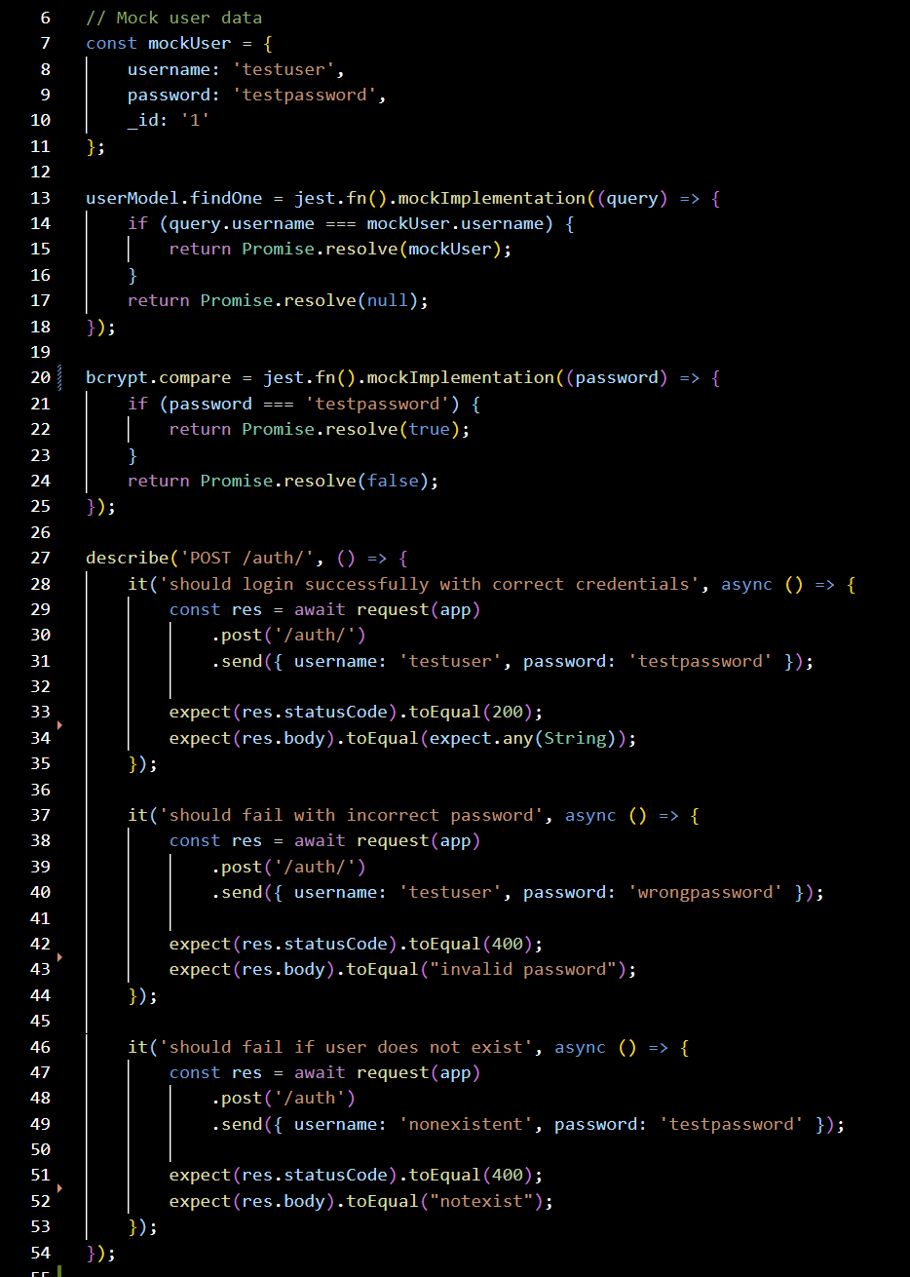
CI/CD Unit Testing

Slide 16
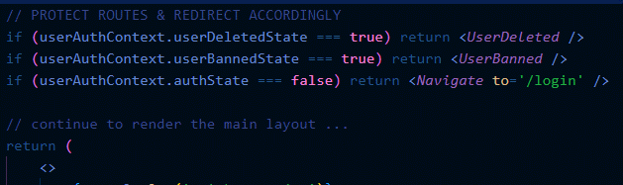
Route Protection
1. Pre-return alternate component if certain conditions are met:

Slide 17
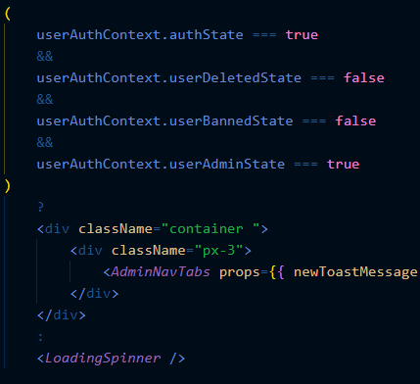
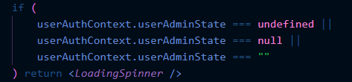
Route Protection
2. Render an intermediate component
while contexts & states are updating
Waiting for !null

Slide 18
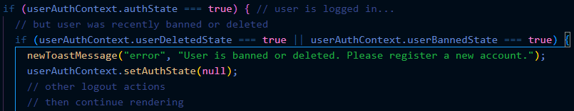
Route Protection
3. Account for privilege changes between redirects.

Slide 19
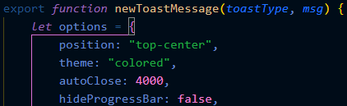

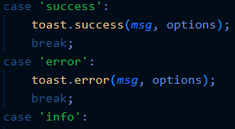
Toast Messages
customToast.js
.
.
.

Slide 20
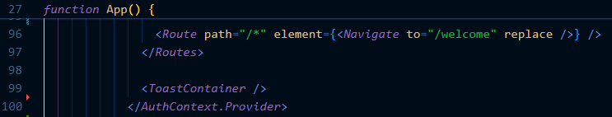
Toast Messages
App.js
Notice: ToastContainer is a global component
i.e. in App.js, nested in Contexts & Router

Slide 21
Challenges Continued
Styling Conflicts
React-Beautiful-DnD Library
Collaborative Functionality

Slide 22
What is React-beautiful-DnD Library
React Beautiful DND is a React drag and drop library for implementing drag and drop functionality into web applications. With this library, you can allow users to intuitively reorder and move elements within your application's interface.

Slide 23
overview steps of implementation
1. npm install react-beautiful-dnd
2. Create the Context
5. State management and send request to the backend
4. Handle onDragEnd function
3. Create draggable and droppable

Slide 24
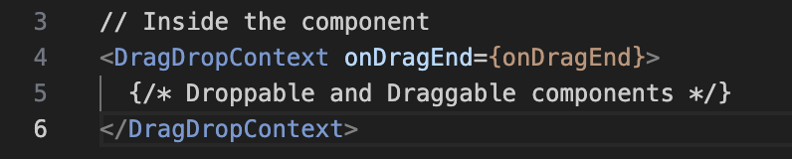
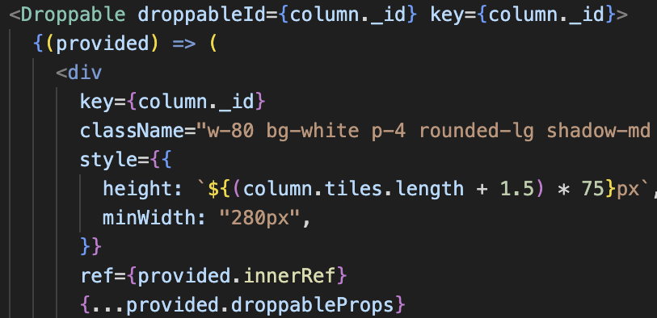
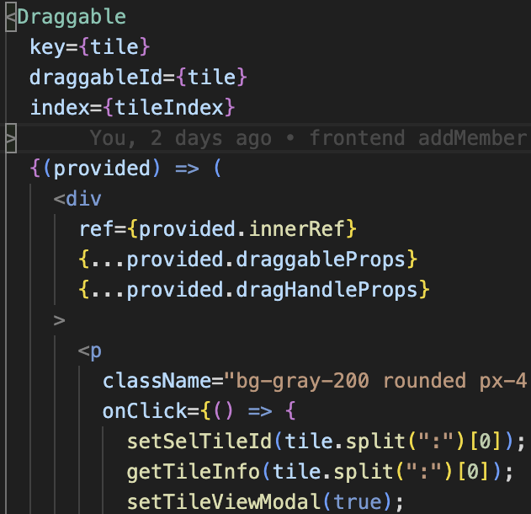
React-Beautiful-DND Library

Slide 25
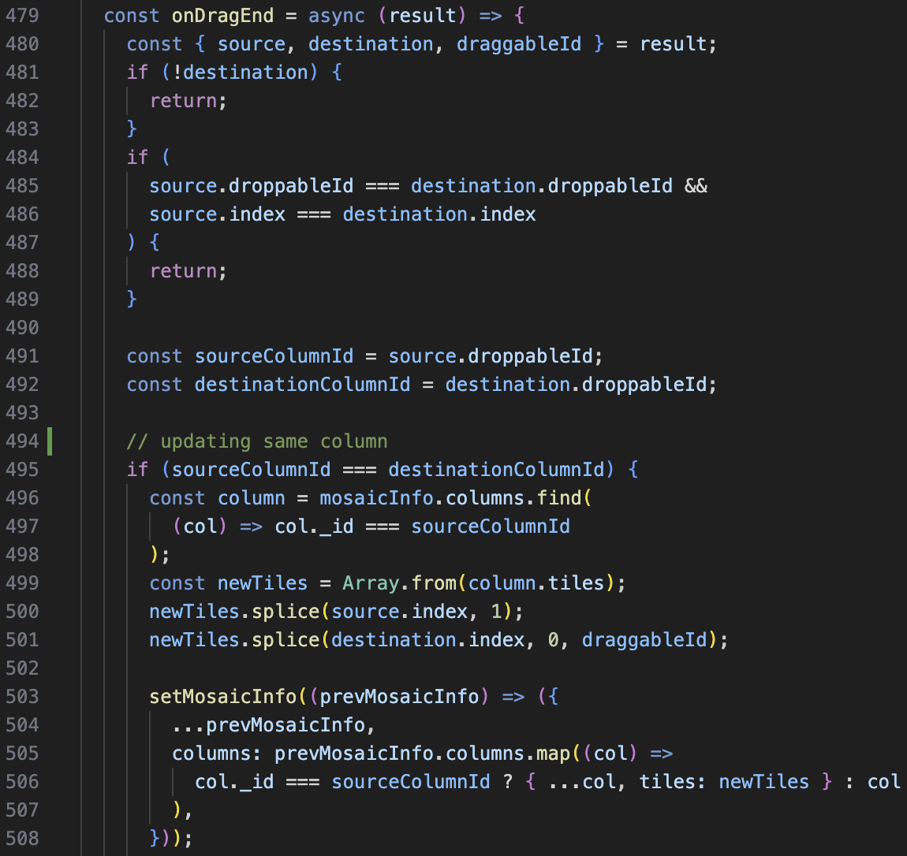
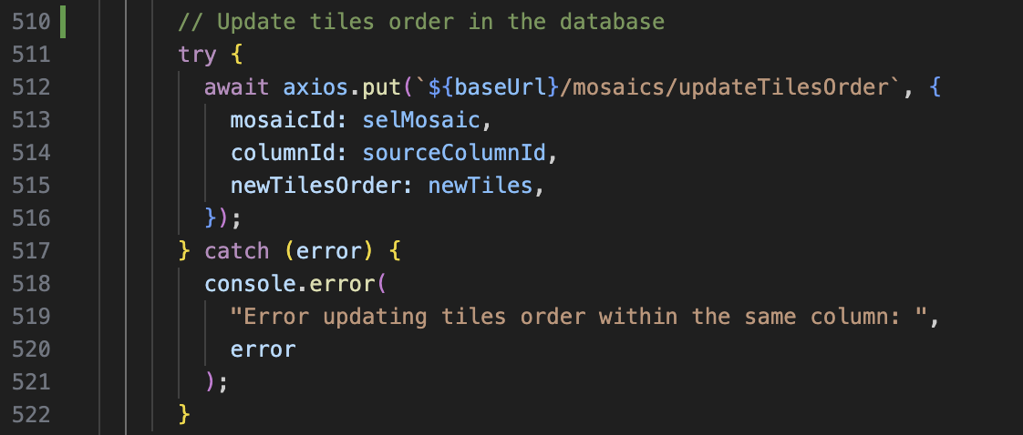
React-Beautiful-DND Library continued

Slide 26
Responsibilities
Sophie
Mosaic Styling
Drag n Drop
Collaborative functionality
Soliloquy
Nicholas
Hosting (Site, Database, File Storage)
Login
Registration
Context-Based Styles
Landing page
Homepage
General Styling
Benjamin
Mosaic functions
Database Implementation
CI/CD Pipeline
User settings page
Chat
Unit Tests
Websocket Impl.
File upload
Protected Routes
Admin Portal
User CRUD
Charts
Toast Messages

Slide 27
Future Work for Projectile
Comments
Deadline Notification
Drag and Drop Columns
Prettier UI
Edit title on Mosaic

Slide 28

Summary
ProjecTile focuses on developing an interactive mosaic board application that empowers users to organize tasks with tiles and columns, collaborate and chat with team members, and manage projects efficiently and effortlessly

Slide 29
Thank You
Questions?

